Slide 1
One Nation, Many Tribes
Linda Sue Warner, Ph.D.
Northeastern Oklahoma A &M
Miami, OK
November 28, 2012

Slide 2
Place & Identity
Who You are
Where you come from
Where you will go
..
Notes:
Place is a dynamic because it is actualized as honoring your relatives, those who came before and those will come after and because it links the individual with the community

Slide 3
Issues of Place
denial of rights to land,
denial of use of and access to natural resources,
ties to the environment that are disrupted,
cultural identity that is weakened.

Slide 4
Sacred Land
What counts as the sacred is linked to both the sacrelization of that which has been profaned (i.e., the killing of local inhabitants by invaders transforms the spot from just ‘our land’ to ‘the sacred spot”, and also to the profaning of a place that is already considered sacred by the local inhabitants (i.e. trampling of ancient burial sites)

Slide 5
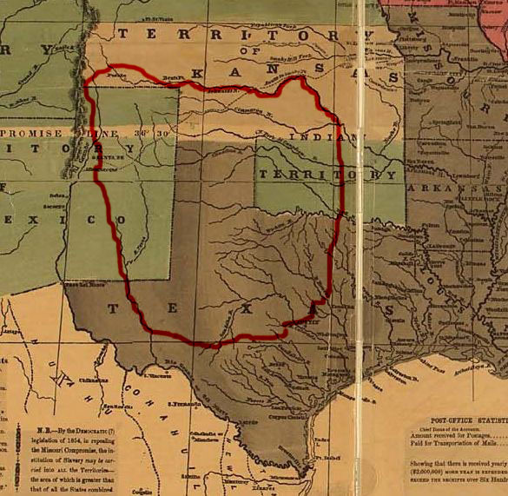
Comanches
When reviewing the replication of a map of Austin, Texas, Hämäläien describes the “cartographic dispossession” of the American Southwest. The map depicts a Euro-centric bias about the era and “diminished and delegitimized the power and territorial claims of indigenous inhabitants”
Notes:
(Hämäläien 195). The Comanche Empire

Slide 6
Seven Generations
We do not inherit the land from our ancestors; we borrow it from our children.

Slide 7
Kill the Indian, Save the Man
Pratt’s charge to Congress was to “put yourself in his (the Indian’s) place.” Pratt’s advocacy of boarding schools as places to assimilate Indians created a legacy that today is a cornerstone for the sites of conscience dialogue that includes the Gulag Museum in Russia and the District Six Museum in South Africa and a potential site in North America—each a testimony to the inhumane practice of removing people from their “place.”

Slide 8
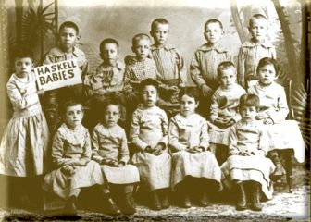
Haskell

Slide 9
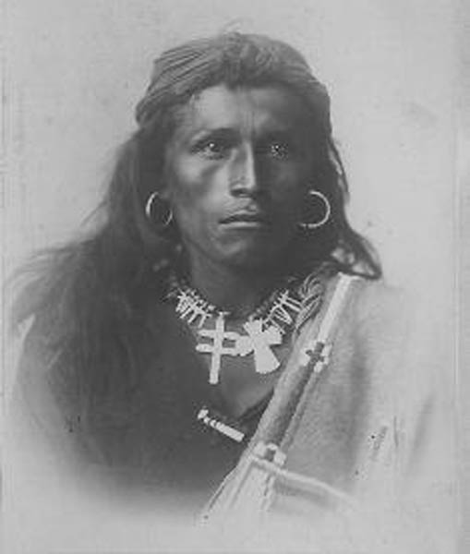
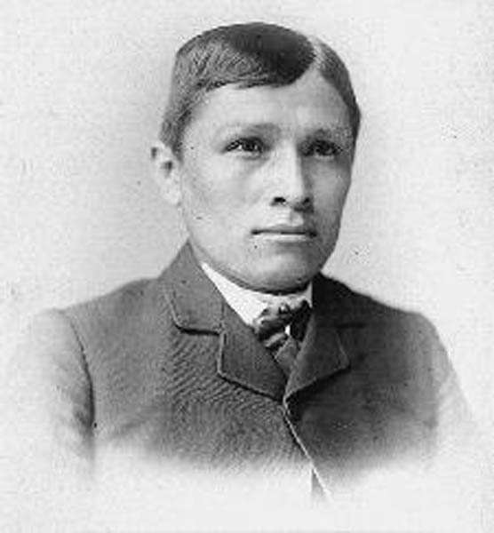
Notes:
Carlisle

Slide 10
Recovering the Sacred
You taught me language; and my profit on’t
Is, I know how to curse
Notes:
The Tempest

Slide 11
Federal Court Interpretations
The federal courts do not apply either the First Amendment or the American Indian Religious Freedom Act of 1978 (AIRFA) in the safeguarding of or access to sacred sites.
Notes:
Today the U.S. government’s true commitment to protecting the religious freedom for all people arguably extends to American Indians, however, protection for sacred sites is uncertain and intermittent

Slide 12
NAGPRA
In 1990, The United States Congress passed the Native American Protection and Repatriation Act (NAGPRA) with the intention of ensuring that ancestral remains and sacred objects would be returned to tribes.

Slide 13
a substantial likelihood of success on the merits; irreparable harm to the Tribe if the injunction is denied; the threatened harm to the tribe outweighs any harm to the U.S. Army; issuance of the injunction would not be adverse to the public interest.
Medicine Bluffs
Notes:
On September 23, 2008—Comanche Tribe injunction

Slide 14
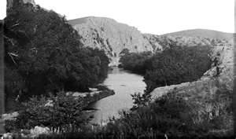
Notes:
Medicine Bluffs late 1800s

Slide 15
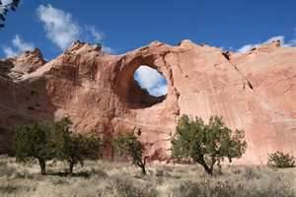
Navajo
Mount Blanca (Tsisnaasjini' - Dawn or White Shell Mountain)
Sacred Mountain of the East near Alamosa in San Luis Valley, Colorado
Mount Taylor (Tsoodzil - Blue Bead or Turquoise Mountain)
Sacred Mountain of the South northwest of Laguna, NM
San Francisco Peaks (Doko'oosliid - Abalone Shell Mountain)
Sacred Mountain of the West near Flagstaff, Arizona
Mount Hesperus Dibé Nitsaa (Big Mountain Sheep) - Obsidian Mountain
Sacred Mountain of the North La Plata Mountains, CO

Slide 16
Hawaii
For Native Hawaiians, Elizabeth Lindsey notes that a sense of place speaks not only to the genealogy of Hawaiian people, but also to their destiny. They see their place, puuhonua, as a sanctuary and, therefore, as a sacred place..
Notes:
The sense that place is the community and that it is situational permeates each of these site-specific locations.

Slide 17
Reservations
Tribal lands are rich in mineral resources; two thirds of the uranium ore, one fourth of the readily accessible low sulfur coal and one fifth of the oil and natural gas that the United States possesses is located within the boundaries of American Indian reservations.
Notes:
Pickering, p. 216

Slide 18
tiyuwosla icupi
Raising a tipi
Creating a home
Indigenous Evaluation

Slide 19
Place
In indigenous knowledge systems, tribal communities’ ways of thinking and knowing can be seen in geography, in cultural identity, and in individual behavior
Notes:
that space is defined as the geography designated by American Indian populations, but that place is defined as a political designation.

Slide 20
Counter Narratives
American Indian culture, traditions, languages and practices have survived an unusual amount of oppressive federal policies despite being treated as misplaced objects, mascots, and stereotypes they remain resilient.
Notes:
The discourse on place and identity lead us to questions of “home” for indigenous people and the ability to maintain both in the 21st century.

